Slide 1

IT-C
Data Analysis & Machine Learning Using Python Internship
Team Name : Shift Enter
Project Name : Predicting The Survival Of Titanic Passengers
Group Number : 19
Group Members :
Vibhanshu Jaiswal IT-C
Manisha Joshi IT-C

Slide 2

Course Outline
Lesson 1.
Problem Statement
Lesson 2.
Goals & Objective
Lesson 3.
Introduction
Lesson 4.
Motivation
Lesson 5.
Software Required

Slide 3
Course Outline
Lesson 7.
Implementation
Lesson 8.
Importing The Necessary Libraries
Lesson 9.
Data Description
Lesson 6.
Logistic Regression

Slide 4

Problem Statement:
The Titanic dataset provides observations for each passengers & the survival of outcome. The problem statement entails predicting whether a passenger would survive or not survive given the features such as passenger class, sex, fare, age, number of siblings/spouse aboard, number of parents/children aboard, and others.
In this presentation, I’ve analyzed each of the started features with respect to survival outcome based on the Titanic dataset using Tableau visualization techniques.
This analysis based on data visualization can be a very effective method in feature selection.

Slide 5

Goals & Objective :
The purpose of this project is to understand all those causes/ attributes/ factors on which survival probability of a passenger depends.
The objective of this project was to build a classification model that could successfully determine whether a Titanic passenger lived or died.

Slide 6

Introduction :
The sinking of the RMS Titanic is one of the most infamous shipwrecks in history.
In this challenge, we ask you to complete the analysis of what sorts of people were likely to survive.
In particular, we ask you to apply the tools of machine learning to predict which passengers survived the tragedy.

Slide 7

Motivation :
“Titanic” was the famous tragedy of the maritime history, we all are aware of this fact. My motivation for this project is from the movie Titanic(1997) which led me to choose this objective to know more in deeper about this calamity.
This was also the result of ill planning and preparation of ill planning and preparation of decision making authority(like decrement in the total no. of lifeboats)
The motive is to examine all those aspects due to which that travel result into the terrific tragedy and finding out some fruitful points so that we could apply them and could prevent the occurrence's of such events in future.

Slide 8

Software Required :
1. Analyzing : NumPy, Pandas, Sci-Kit Learn.
2. Visualization : Matplotlib, Seaborn
Library Used
Tools Used
1. Anaconda Navigator - 5.3.0
2. Jupyter Notebook – 6.0.3

Slide 9

Logistic Regression :
Logistic regression is basically a supervised classification algorithm. In a classification problem, the target variable or output (y), can take only discrete values for given set of features or inputs (x).

Slide 10

Implementation :
Importing the necessary libraries.
Importing the dataset.
Cleaning and analyzing the dataset.
Using logistic regression for making prediction.

Slide 11

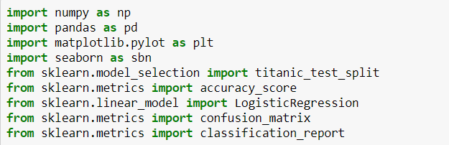
Importing the necessary libraries :

Slide 12
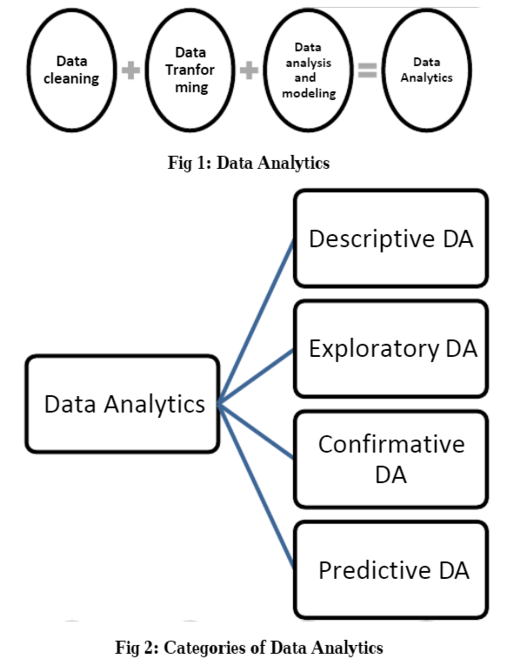
Data Analytics And Its
Categories :

Slide 13
Data Description :
As we know the large no. of passengers & crew around 2224 were there in the liner and many didn’t survive, thus there are some attributes on the basis of which we can find about their survival probability which have around 891 observations and 12 columns in the dataset and I took this dataset from Kaggle:
Survived: Outcome of survival (0 = No; 1 = Yes)
Pclass: Socio-economic class (1 = Upper class; 2 = Middle class; 3 = Lower class)
Name: Name of passenger
Sex: Sex of the passenger
Age: Age of the passenger (Some entries contain NaN)
SibSp: Number of siblings and spouses of the passenger aboard
Parch: Number of parents and children of the passenger aboard
Ticket: Ticket number of the passenger
Fare: Fare paid by the passenger
Cabin: Cabin number of the passenger (Some entries contain NaN)
Embarked: Port of embarkation of the passenger (C = Cherbourg; Q = Queenstown; S = Southampton)

Slide 14

Thank You!

